Slide 1
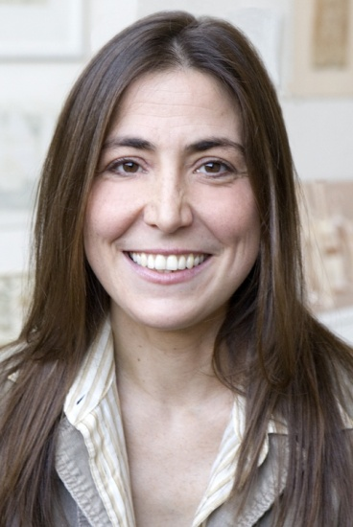
When You Reach Me
Rebecca Stead

Slide 2
Rebecca Stead

Slide 3
Things You Keep in a Box pp1-2
Background:
“The $20,000 Pyramid”
Character Development
From what point of view is the story told?
What do you think happened last fall and winter?
Who do you think asked the narrator to write a letter? What has happened to this person?
Why is this chapter entitled “Things You Keep in a Box”?

Slide 4
Things That Go Missing pp3-6
Vocabulary
latchkey kid
Character Development: Chart character traits for the narrator, the narrator’s mom, and Richard.

Slide 5
Thing You Hide pp7-11
Vocabulary
repulsive
prosecutor
Allusion
“It was a dark and stormy night.”
Migrant Farm Workers Strike in California-Ceasar Chavez
Miranda Warnings
Shakespeare’s The Tempest
Symbol
key
Character Development
Setting
What is the title of the book the narrator has read so many times? What is the significance of this book?
Do you think Miranda’s mother named her after a kidnapper?
Why do you think Sal is no longer Miranda’s best friend?
Who is the mysterious person Miranda keeps referring to?
This is the second chapter in which a key is mentioned. What is the importance of a key?
Why is the chapter entitled “Things You Hide”?

Slide 6
The Speed Round pp12-15
Vocabulary
tenant
Character Development
Setting

Slide 7
Things That Kick pp16-18
Vocabulary
Character Development
Why does Miranda say she lost Sal? What do you think happened to him? Did the laughing man have anything to do with it?

Slide 8
Things That Get Tangled pp19-20
Vocabulary
Symbol
knots
Character Development
Miranda is being asked to write a letter that explains “the story of what happened and everything that led up to it.” What is her problem related to this task?
What do you think happened the day Sal got punched?

Slide 9
Things That Stain pp21-24
Vocabulary
Character Development
Why would Sal getting punched end Miranda’s friendship with him? Does that make any sense to you?

Slide 10
Mom’s Rules for Life in New York City pp25-26
Vocabulary

Slide 11
Things You Wish For pp27-29
Vocabulary

Slide 12
Things That Sneak Up on You pp30-31
Vocabulary

Slide 13
Things That Bounce pp32-36
Vocabulary

Slide 14
Thing That Burn pp37-38
Vocabulary

Slide 15
The Winner’s Circle pp39-42
Vocabulary

Slide 16
Things You Keep Secret pp43-53
Vocabulary

Slide 17
Things That Smell pp54-56
Vocabulary

Slide 18
Things You Don’t Forget pp57-59
Vocabulary

Slide 19
The First Note pp60-61
Vocabulary

Slide 20
Things on a Slant pp62-63
Vocabulary

Slide 21
White Things pp64-66
Vocabulary

Slide 22
The Second Note pp67-70
Vocabulary

Slide 23
Things You Push Away pp71-72
Vocabulary

Slide 24
Things You Count pp73-75
Vocabulary

Slide 25
Messy Things pp76-78
Vocabulary

Slide 26
Invisible Things pp79-80
Vocabulary

Slide 27
Things You Hold on To pp81-83
Vocabulary

Slide 28
Salty Things pp84-87
Vocabulary

Slide 29
Things You Pretend pp88-91
Vocabulary

Slide 30
Things That Crack pp92-94
Vocabulary

Slide 31
Things Left Behind pp95-96
Vocabulary

Slide 32
The Third Note pp97-99
Vocabulary

Slide 33
Things That Make No Sense pp100-106
Vocabulary

Slide 34
The First Proof pp107-109
Vocabulary

Slide 35
Things You Give Away pp110-114
Vocabulary

Slide 36
Things That Get Stuck pp115-117
Vocabulary

Slide 37
Tied-Up Things pp118-122
Vocabulary

Slide 38
Things That Turn Pink pp123-127
Vocabulary

Slide 39
Things That Fall Apart pp128-131
Vocabulary

Slide 40
Christmas Vacation pp132-133
Vocabulary

Slide 41
The Second Proof pp134-136
Vocabulary

Slide 42
Things in an Elevator pp137-142
Vocabulary

Slide 43
Things You Realize pp143-145
Vocabulary

Slide 44
Things You Beg For pp146-147
Vocabulary

Slide 45
Things That Turn Upside Down pp 148-153
Vocabulary

Slide 46
Things That Are Sweet pp154-156
Vocabulary

Slide 47
The Last Note pp157-162
Vocabulary

Slide 48
Difficult Things pp163-165
Vocabulary

Slide 49
Things That Heal pp166-170
Vocabulary

Slide 50
Things You Protect pp171-178
Vocabulary

Slide 51
Things You Line Up pp179-181
Vocabulary

Slide 52
The $20,000 Pyramid pp182-186
Vocabulary

Slide 53
Magic Thread pp187-189
Vocabulary

Slide 54
Things That Open pp190-192
Vocabulary

Slide 55
Things That Blow Away pp193-195
Vocabulary

Slide 56
Sal and Miranda, Miranda and Sal p196
Vocabulary

Slide 57
Parting Gifts p197
Vocabulary

Slide 58
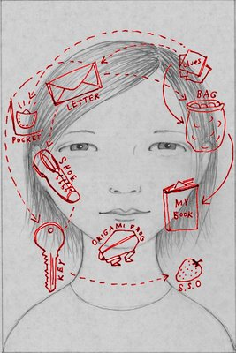
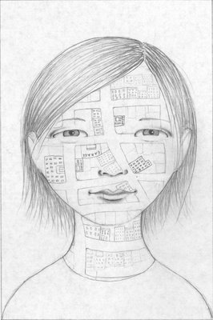
Novel Projects

