Slide 1
Tracker
Gary Paulsen

Slide 2
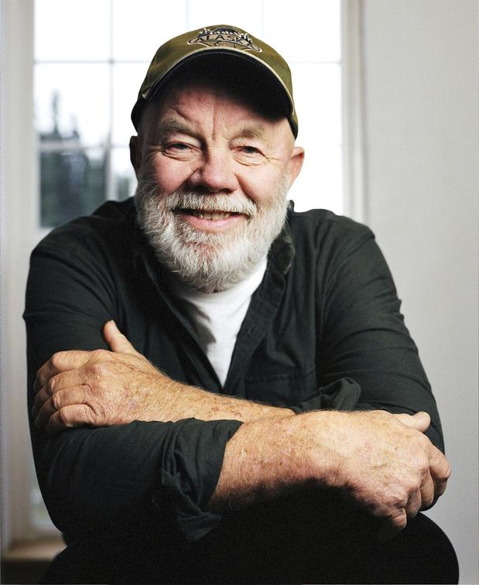
Gary Paulsen
Author Notes

Slide 3
Vocabulary
Chapter One: pages 3-10
ruddy
kerosene
oilcloth
Character Development
Setting
Conflict
Symbols
Figurative Language
Why does John not want to admit that death is coming? Use evidence from the text to support your thinking. How would you feel if you were in his place? Explain.
What do you do to take your mind off of something that is bothering you? Try to connect your actions with those of John.

Slide 4
Vocabulary
Chapter Two: pages 11-19
manure
ritual
silage
silo
recoiled
Character Development
Setting
Conflict
Symbols
Figurative Language
What kind of work ethic does John have? Use evidence from the text to support your thinking. What kind of work ethic do you have? Explain your work ethic in relation to John’s work ethic.
Do you think that there are other parts of living that only change when you look away and then look back? Explain your thoughts.
Explain your views about school in relation to John’s views about school.

Slide 5
Vocabulary
Chapter Three: pages 20-27
bloat
granary
stoneboat
instinct
Character Development
Setting
Conflict
Symbols
Figurative Language
Describe the emotion John is feeling about seeing the doe. Use evidence from the text to support your thinking. How is this important to the development of the story?
What do you think the doe is waiting for? Explain your thinking.

Slide 6
Vocabulary
Chapter Four: pages 28-34
thrums
bucks
tallow
caterwauling
roiling
Character Development
Setting
Conflict
Symbols
Figurative Language
What purpose does this chapter serve in the development of the story? Use evidence to support your thinking.

Slide 7
Vocabulary
Chapter Five: pages 35-44
assailed
privy
Character Development
Setting
Conflict
Symbols
Figurative Language
Think about the comment John’s grandma made, “I just try to know as much as I can about something before I talk about it.” Do you think this is good advice? Could there be a situation where this advice wouldn’t be good? Explain your thinking.
If you were John, would you have said goodbye to your grandfather? Explain.
What can you infer is going to happen when John is hunting? Explain your thinking using evidence from the text.

Slide 8
Vocabulary
Chapter Six: pages 45-51
peat bog
quagmire
defied
bounded
Character Development
Setting
Conflict
Symbols
Figurative Language
What purpose does this chapter serve in the development of the story? Use evidence from the text to support your thinking.

Slide 9
Vocabulary
Chapter Seven: pages52-56
unduly
wading
Character Development
Setting
Conflict
Symbols
Figurative Language
Do you think John will kill the doe and make meat? Explain your thinking based on evidence from the text.

Slide 10
Vocabulary
Chapter Eight: pages 57-65
intermittently
grouse
persists
relish
Character Development
Setting
Conflict
Symbols
Figurative Language
What was John’s motivation for not shooting the deer? Use evidence from the text to support your thinking.
Why does John continue to follow the doe, even though he didn’t kill her when he had the chance? What outcome could he possibly be hoping for?

Slide 11
Vocabulary
Chapter Nine: pages 66-73
recourse
endurance
taint
terrain
Character Development
Setting
Conflict
Symbols
Figurative Language
Why is it so important to John to cheat death?
Describe the weight that has been lifted by John’s decision to leave the rifle. What is causing this emotion? Use evidence from the text to support your thinking.

Slide 12
Vocabulary
Chapter Ten: pages 74-79
beckoning
Character Development
Setting
Conflict
Symbols
Figurative Language
How does the doe’s behavior change throughout the day and into the night? What is the significance of her actions?
How does John change?
Why do you think John believes the deer came for him at the barn to dance him away? Explain.

Slide 13
Vocabulary
Chapter Eleven: pages 80-84
pretense
bile
imprint
muzzle
Character Development
Setting
Conflict
Symbols
Figurative Language
Why did John go to such lengths to track the deer, only to touch her and let her go? Do you think his behavior was justified? Explain using evidence from the text.

Slide 14
Vocabulary
Chapter Twelve: pages 85-90
searing
Character Development
Setting
Conflict
Symbols
Figurative Language
How has John changed from the beginning of the story to now? Use evidence from the text to support your thinking.
Final thoughts?

Slide 15
Novel Projects
Research: Write a research report on deer. Include the life cycle, habitat, diet, and special adaptations in your report.
Narrative: Write a short story about the day John’s grandfather dies.
Narrative: Write about the hunt from the deer’s perspective.
Argument: Write an argument for or against hunting. Be sure to include strong evidence to support your opinion.

