Slide 1
The Watsons Go to Birmingham-1963
Christopher Paul Curtis

Slide 2
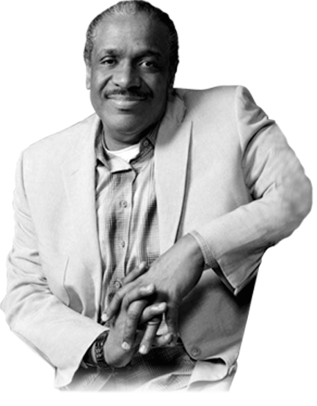
Christopher Paul Curtis
Author Biography

Slide 3
Vocabulary
Chapter 1: And You Wonder Why We Get Called the Weird Watsons
pages 1-19
Character Development
Figurative Language
Allusion: Narcissus
Do you think that the Watsons are a typical family? Explain using evidence from the text.
How does Kenny feel about his older brother, Byron? Use evidence to support your position.

Slide 4
Vocabulary
Chapter 2: Give My Regards to Clark, Poindexter
pages 20-31
hostile
vital
emulate
punctual
Character Development
Figurative Language
Allusion: Langston Hughes
How do you think Byron feels about his younger brother, Kenny, being smarter than he is? How would you feel if you were in his place? Use evidence to support your position.
Why does Kenny think that the new kids are his personal savers? How will this addition of two new characters possibly change the story?

Slide 5
Vocabulary
Chapter 3: The World’s Greatest Dinosaur War Ever
pages 32-46
radioactive
Character Development
Figurative Language
Describe how the relationship between Kenny and Rufus is developing. Cite evidence from the text.
Why would Kenny laugh at Rufus on the bus when he doesn’t like being laughed at himself?

Slide 6
Vocabulary
Chapter 4: Froze-Up Southern Folks
pages 47-63
hypnotized
Character Development
Figurative Language
Is it funny to watch someone being bullied? How do you feel when you see someone being bullied?
Why do you think Larry Dunn bullies people? Cite evidence from the text.
Does Kenny’s opinion of Larry Dunn change in this chapter? Explain.

Slide 7
Vocabulary
Chapter 5: Nazi Parachutes Attack America and Get Shot Down over the Flint River by Captain Byron Watson and His Flamethrower of Death
pages 64-74
Character Development
Figurative Language
Do you think Byron will ever play with matches again? Explain.
Were the mother’s action justified? Explain citing evidence from the text.

Slide 8
Vocabulary
Chapter 6: Swedish Cremes and Welfare Cheese
pages 75-85
welfare
peon
Character Development
Figurative Language
Why did Byron throw up? Was it because of the cookies and the apples, or was it something else? Explain using evidence from the text.
What is your opinion of Byron? How would you characterize him? Cite evidence from the text to support your opinion.

Slide 9
Vocabulary
Chapter 7: Every Chihuahua in America Lines Up to Take a Bite out of Byron
pages 86-99
Character Development
Figurative Language
What do you think the TT AB-700 is? And, what does it have to do with Byron’s latest caper? Use evidence to support your thinking.

Slide 10
Vocabulary
Chapter 8: The Ultra-Glide!
pages 100-120
pinnacle
symphonic
haphazardly
high-fidelity
Character Development
Figurative Language
Why did Mr. Watson make all of the improvements to the Brown Bomber? Explain in detail his motives.
Do you think Mr. and Mrs. Watson are making a good parenting decision? Explain.

Slide 11
Vocabulary
Chapter 9: The Watsons Go to Birmingham-1963
pages 121-137
Character Development
Figurative Language
What do you think Mr. Watson’s real motivation was for installing a record player in the Brown Bomber? Was it to keep is wife from divorcing him, or could it be something else?
How is Byron reacting to the trip to Birmingham?

Slide 12
Vocabulary
Chapter 10: Tangled Up in God’s Beard
pages 138-148
Character Development
Figurative Language
Describe the impact the trip is having on the Watson family.

Slide 13
Vocabulary
Chapter 11: Bobo Brazil Meets the Sheik
pages 149-151
Character Development
Figurative Language
What kind of an impact did meeting Grandma Sands have on Byron? Do you think he has changed, or does he have a plan?

Slide 14
Vocabulary
Chapter 12: That Dog Won’t Hunt No More
pages 162-168
wilier
Character Development
Figurative Language
What purpose in the overall plot does this chapter serve?

Slide 15
Vocabulary
Chapter 13: I Meet Winnie’s Evil Twin Brother, the Wool Pooh
pages 169-179
trespassing
whirlpool
Character Development
Figurative Language
Summarize what happened in this chapter.

Slide 16
Vocabulary
Chapter 14: Every Bird and Bug in Birmingham Stops and Wonders
pages 180-190
Character Development
Figurative Language
Why is this chapter titled ‘Every Bird and Bug in Birmingham Stops and Wonders’?
Write a reflection about this chapter. How does it make you feel? Use evidence to support your thinking.

Slide 17
Vocabulary
Chapter 15: The World-Famous Watson Pet Hospital
pages 191-206
Character Development
Figurative Language
How has the story changed?
Why does Kenny hide behind the couch in the ‘World-Famous Watson Pet Hospital’?
What does the Wool Pooh represent? Explain using evidence from the text.
Is Byron right? Will Kenny be alright?

Slide 18
Vocabulary
Epilogue
pages 207-210
pervasive
segregation
provoke
civil rights
Reflect on what you have learned about yourself and the world from reading this novel.

Slide 19
Novel Projects
Theme: What is the theme of this story?
Research the Civil Rights Movement of the 1960’s. Write a report on the information you learn during your research.

