Slide 1
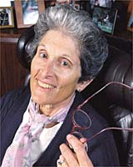
“The Sound of Night”
Maxine Kumin

Slide 2
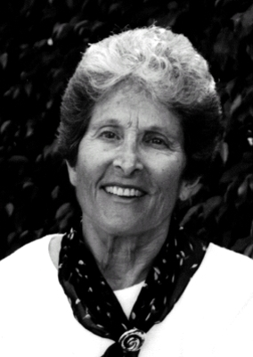
Maxine Kumin
Biography
Video Biography

Slide 3
Connect to the Poem
Have you ever gone camping? If so, then you’ve probably listened to a strange and wonderful chorus of night sounds. Make a list of animals you’ve heard at night and the sounds they make.

Slide 4
Building Background
“The Sound of Night” is a poem that describes the noises certain animals make at night. Camping can be a strange or even scary experience for people who aren’t used to the outdoors. Like the speaker, frequent campers may learn to identify the sounds made by animals they can’t see.
Although some of the descriptive words, such as hugger-mugger, might seem as if the poet invented them for their sound qualities, they are actual words that can be found in a dictionary.
As you read “The Sound of Night,” ask yourself how the poet creates a memorable place for her readers.

Slide 5
“The Sound of Night”
And now the dark comes on, all full of chitter noise.
Birds huggermugger crowd the trees,
the air thick with their vesper cries,
and bats, snub seven-pointed kites,
skitter across the lake, swing out,
squeak, chirp, dip, and skim on skates
of air, and the fat frogs wake and prink
wide-lipped, noisy as ducks, drunk
on the boozy black, gloating chink-chunk.

Slide 6
And now on the narrow beach we defend ourselves from dark.
The cooking done, we build our firework
bright and hot and less for outlook
than for magic, and lie in our blankets
while night nickers around us. Crickets
chorus hallelujahs; paws, quiet
and quick as raindrops, play on the stones
expertly soft, run past and are gone;
fish pulse in the lake; the frogs hoarsen.

Slide 7
Now every voice of the hour—the known, the supposed, the strange,
the mindless, the witted, the never seen—
sing, thrum, impinge,3 and rearrange
endlessly; and debarred4 from sleep we wait
for the birds, importantly silent,
for the crease of first eye-licking light,
for the sun, lost long ago and sweet.
By the lake, locked black away and tight,
we lie, day creatures, overhearing night.

Slide 8
Reading Check & Interpretations
Note the repeated consonant sound in lines 4-6. What effect does this sound device have on your reading of the poem?
What are the words the poet uses in the first stanza to represent the sounds that night animals are making?
Does the poet’s unique and memorable use of language help you imagine a campsite? Explain why or why not.

Slide 9
Reading Check & Interpretations
What are three night animals the poet describes?
What does the speaker mean in line 22 when she says she is “debarred from sleep”?
Does the speaker like, dislike, or have mixed feelings about camping outside all night? Note words and phrases from the poem that support your opinion.

Slide 10
Reading Check & Interpretations
With what alliterative phrase does the poet describe the early dawn?
Identify three distinct examples of onomatopoeia in the poem. Which example do you think is the most lively and musical? Explain.
What words or phrases in the poem lead you to conclude that the speaker appreciates the outdoor setting as a memorable place?

Slide 11
Writing
Think of a memorable place that you have visited. The place may be in nature or somewhere else. Write a one-stanza poem in which you show why the place is special to you. Describe the place using onomatopoeia and alliteration.

