Slide 1
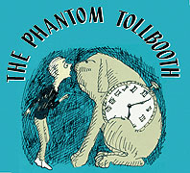
Norton Juster

Slide 2
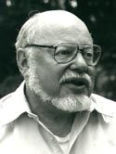
Norton Juster
Scholastic Biography

Slide 3
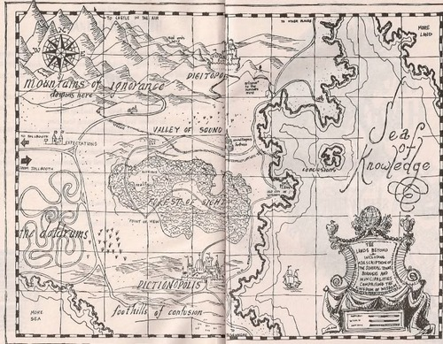

Slide 4
Figurative Language & Beyond
As you read The Phantom Tollbooth, keep a chart of characters and their impact on the protagonist Milo, figurative language, and multiple meaning words (including homophones, homographs, and homonyms).

Slide 5
Figurative Language & Beyond
Some Types of Figurative Language
Alliteration: Repeated consonant sounds at the beginning of several words in a phrase (Robbie saw rabbits resting by roses.)
Hyperbole: An exaggeration (That building can touch the clouds.)
Idiom: An expression that cannot be understood from the individual meanings of its elements, as in kick the bucket or under the weather.
Irony: The opposite of what is meant.
Metaphor: A comparison of two unlike things that suggests a similarity between the two items. (Love is a rose.)
Onomatopoeia: Words that sound like what they are. (POP! BAM! Slosh)
Personification: Making an inanimate object or animal act like a person
Puns: A word or words, which are formed or sounded alike, but have different meaning; to have more than one possible meaning. (Using that pencil is pointless.)
Simile: A comparison using "like" or "as" (She sings like an angel.)

Slide 6
Chapter 1: Milo pp9-15
Vocabulary: dejectedly 9, glumly 11, tollbooth 12, erected 12, diction 14
Response:
  Describe a time when you were bored and had nothing worthwhile to do. Relate your experience to the main character, Milo.
  Comment on the following quote: “And since no one bothered to explain otherwise, he regarded the process of seeking knowledge as the greatest waste of time of all.” (p9)
  Describe Milo’s character. Use specific language and evidence from the story to support your thinking.

Slide 7
Word Play: Chapter 1
Lands beyond
Pay a toll
Plenty of time
Wasted time
Fare/fair

Slide 8
Chapter 2: Beyond Expectations pp16-31
STOP! After reading page 16: Does this remind you of any other books or movies? Make a connection.
Vocabulary: effusive 18, monotonous 22, Doldrums 22, lethargic 24, surmise 24, indignantly 25, dawdle 26, loiter 27, conciliatory 27,
Foreshadowing: As you read, look for examples of foreshadowing.

Slide 9
Chapter 2: Beyond Expectations pp16-31
Response:
  What purpose does the Whether Man serve? Explain using evidence from the story.
  In this chapter you find yourself in the Doldrums. Describe what the Doldrums is and how the use of imagery helps you understand the concept. Make connections between Milo at the beginning of the story to where he is now. Explain your thinking.
  What purpose does the watchdog serve? Explain using evidence from the story?

Slide 10
Word Play: Chapter 2
Beyond expectation
Whether/weather
Which(ever) way the wind is blowing
Find my way
Raining on me
Fork in the road
Air hung heavily
Bide our time
Put off for tomorrow what we could have done today
Sniffing around
Watchdog
Killing time
Wheels began to turn
Synonyms for think
Synonyms for dawdle

Slide 11
Chapter 3: Welcome to Dictionopolis pp32-44
Vocabulary: gruff 32, interjected 33, overwrought 33, disrepute 34, perilously 34, unabridged 38, reticence 43, connotation vs. denotation 40
Response:
  Explain what the following quote means: “. . . you must pick your words very carefully and be sure to say just what you intend to say. . .” Use specific examples to prove your point.
  What was the wisest thing that Milo heard all day in Dictionopolis?

Slide 12
Word Play: Chapter 3
Hit a bump in the road
Time marches on
Time waits for no man
Money doesn’t grow on trees
Suffixes: cence, sense
(Got) nothing but time
Easy as falling off a log

Slide 13
Chapter 4: Confusion in the Market Place pp45-56
Vocabulary: tumult 45, quagmire 47, flabbergast 47, balderdash 53, disdain 53, humbug 53, slavish 54, menaced 56, bunting 56
Response:
  How do you think letters would taste. Select a letter (one not used as an example in the story) and use sensory language to describe how it tastes.
  What is the significance of the two new characters that you are introduced to in this chapter, Spelling Bee and Humbug? Explain thoroughly.

Slide 14
Word Play: Chapter 4
Happy-go-lucky
Minding my own business
Bee in your bonnet
Sound the alarm
Upsetting the applecart
Wreaking havoc
Mincing words

Slide 15
Chapter 5: Short Shrift pp58-70
Vocabulary: short shrift 58, striding 59, scarcely 59, sowing 62, commendable 65, macabre 67, miserly 67, disconsolate 68
Response:
  Do you agree with the Which’s statement, “. . . while it is wrong to use too few (words), it is often far worse to use too many,”? Explain.
  What does Milo say he will do if he ever gets out of prison? Why does he say this?
  Why do you think the words Rhyme and Reason are capitalized?
  What is the message of this chapter? Use evidence from the chapter to support your thinking.

Slide 16
Word Play: Chapter 5
Get to the bottom of this
Minding my own business
Upsetting the applecart
Wreaking havoc
Mincing words
Sentence
Keep your chin up
Like the smell of wet blankets
Cell/sell
Witch/which
Brevity is the soul of wit
An ill chosen word is the fool’s messenger
Speak fitly or be silent wisely
Silence is golden
Rhyme and reason

Slide 17
Chapter 6: Faintly Macabre’s Story pp71-79
Vocabulary: barren 71, null 71, domain 71, presumption 71, diligently 74, animosity 74, reconcile 76, arbitration 77, ominously 78, agitated 79, superfluous 79
Response:
  Do you agree with the Which when she says, “I’m afraid there’s not much a little boy and a dog could do,”? Explain.
  Why do you think the Which doesn’t let herself out of prison? Explain how the character’s names are of importance in the story.

Slide 18
Word Play: Chapter 6
Warp and woof
Synonyms for vehicle
It goes without saying

Slide 19
Chapter 7: The Royal Banquet pp80-91
Vocabulary: cordially 82, ominously 85, rigmarole 89, ragamuffin 89
Response:
  What is the significance of this chapter? Use evidence from the chapter to support your thinking.

Slide 20
Word Play: Chapter 7
Step lively
Reflections danced dizzily
How time flies
Page
Synonyms for beautiful
Make mountains out of molehills
Split hairs
Make hay while the sun shines
Leave no stone unturned
Hang by a thread
Light meal
Square meal
Eat my words
Just desserts
Don’t bite off more than you can chew
In one ear and out the other
If it isn’t one thing, it’s another
Out of the frying pan into the fire
Don’t have to bite my head off
Synonyms for sorry
Half baked ideas
Swallow that
It never rains but pours
Everything happens for the best

Slide 21
Chapter 8: The Humbug Volunteers pp92-100
Vocabulary: repast 92, distraught 93, steadfast 96, harrowing 96, chasm 96, perilous 97, crags 97, concurred 97
Response:
  Describe Humbug’s character using evidence from the story.
  What is the more serious problem? Why do you think this way?
  The theme of importance of words and word choice is reiterated in this chapter. How does the development of this concept shape Milo’s personal discovery? Use evidence to support your thinking.

Slide 22
Word Play: Chapter 8
Weakly/weekly
Look at the bright side of things
Drive a bargain
Pull the switch
Lower the boom
Toe the line
Pleased to see someone go

Slide 23
Chapter 9: It’s All in How You Look at Things pp101-108
Vocabulary: resigned 101, promontory 102, beckon 108
Response:
  As you grow up, you always see things in a different way. Compare this with Alec Bings’s point of view.
  What is the theme of this chapter. Use evidence to explain your thinking.

Slide 24
Word Play: Chapter 9
Friendly, cool breeze slapped playfully
Long shadows stretched out lazily
Spirit of adventure
Lure of the unknown
Point of view
The road bent around itself
Feet off the ground
Standing on the ground (grounded)
Can’t see whatever is right in front of your own nose (face)
See what lies behind
See to things
Look after things
See the other side of a question
Overlooks
Walk among the stars

Slide 25
Chapter 10: A Colorful Symphony pp109-126
Vocabulary: emphatically 113, metropolis 115, illusions 115, gingerly 116, profusion 121, gaunt 121, score 124, chroma 124
Response:
  What purpose does the giant-midget man serve? Explain.
  What lesson does Milo learn in the city of Reality?
  Choose a specific scene and describe which instruments would play the soundtrack for the colors. Can you think of a song that might also fit the scene?

Slide 26
Word Play: Chapter 10
Trees closed in around them and arched gracefully toward the sky
Sunlight leaped lightly from leaf to leaf, slid along branches
Slipped my mind
Rooftops shone like mirrors
See with your eyes open
Stripes of purple and orange and crimson and gold piled themselves on top of distant hills
Shafts of light waited patiently
A group of anxious stars
Solemn bass fiddles
Molded the air like handfuls of soft clay
Score
The world looked like an enormous coloring book that had never been used
Had seen right through Milo’s plans

Slide 27
Chapter 11: Dischord and Dynne pp127-143
Vocabulary: chartreuse 129, cacophony 133, discord 133, dissonance 133, apothecary 135, stammered 135, bellowed 136, hubbub 137, din 138, exasperated 140, hysterics 140, concocting 140, pandemonium 143
Response:
  Using the imagery from when Milo conducted the sunrise, draw a picture to illustrate the scene.
  Describe the different gifts that Milo has received throughout his adventure.
  Make a list of onomatopoeic words from this chapter. Now choose a scene to describe using imagery, including onomatopoeia.

Slide 28
Word Play: Chapter 11
Rays of light danced into view
Bass fiddles rested
The purple sun raced quickly across the sky
Better be getting along the easy rolling countryside now stretched before them in a series of dips and rises that leaped up one side of each crest and slide gently down the other in a way that made stomachs laugh and faces frown.
The road, finally making up its mind, plummeted down, as if anxious to renew acquaintance with the sparkling blue stream that flowed below.
The wind grew stronger as if it funneled through rocks
It looks like a wagon
There was a terrible crash from inside the wagon that sounded as if a whole set of dishes had been dropped from the ceiling onto a hard stone floor
Hoarse/horse
As soon as the smog had gotten completely out of the bottle it grasped the beaker of liquid, titled back what would have been its head, if it really had one, and drank it all in three gulps.
With a laugh that sounded like several sirens going off at once
He began to sob all over again in a way that sounded almost exactly like a handful of fingernails being scratched across a mile-long blackboard

Slide 29
Chapter 12: The Silent Valley pp144-159
Vocabulary: laudable 145, avail 146, resolute 150, portal 150, interlude 151, static 152, crestfallen 154
Response:
  Continue to make a list of onomatopoeic words. Now choose one a draw a picture of the shape the sound takes once it is heard.
  How can sounds sometimes tell us things far better than words? Explain.
  How did Milo steal a sound from the fortress in the Silent Valley? Think carefully and then explain.

Slide 30
Word Play: Chapter 12
A thought crossed his mind
Hear/here
Expectant pause

Slide 31
Chapter 13: Unfortunate Conclusions pp160-170
Vocabulary: debris 162, disconsolately 162, conferred 166, strenuous 170
Response:
  Describe the character Canby.
  What were Milo and Tock completely soaked with? Why wasn’t Humbug soaked? What is the significance of this?

Slide 32
Word Play: Chapter 13
It’s on the tip of my tongue
As if even the air was holding its breath
A beautiful island covered with palm trees and flowers beckoned invitingly
He leaped from the car as if stuck by a pin
As tall as can be
Short as can be
As generous as can be
As selfish as can be
As strong as can be
As weak as can be
As smart as can be
As stupid as can be
As graceful as can be
As clumsy as can be
As fast as can be
As slow as can be
As happy as can be
As sad as can be
Jump to conclusions
Sea of knowledge
As friendly as can be

Slide 33
Chapter 14: The Dodecahedron Leads the Way pp171-183
Vocabulary: nimbly 172, doffed 172, admonished 174
Response:
  Describe the two new characters that Milo is introduce to in this chapter.

Slide 34
Word Play: Chapter 14
Sense/cents
High hopes
Narrow escapes
Whole wide world
At long last
Number mine
Mathemagician

Slide 35
Chapter 15: This Way to Infinity pp184-192
Vocabulary: savory 184, pungent 184, conviction 186, magnitude 189
Response:
  Do you have a magic staff? Explain.
  Why does Milo think he will be back in a few minutes?

Slide 36
Word Play: Chapter 15
Drifted easily from one anxious nose to another

Slide 37
Chapter 16: A Very Dirty Bird pp193-210
Vocabulary: melancholy 198, nonchalantly 200, disdainfully 201, pining 203, unkempt 204, maliciously 204, haughtily 205, amiably 205, brandishing 208
Response:
  What is wrong with the .58 of a boy’s logic with averages? Explain.
  Explain what the Mathemagician means by being wrong is hardly worth the effort.
  Explain Milo’s comment, “. . .everybody is so terribly sensitive about the things they know best.”
  What problem is even more serious? Who else said this in the story? Have your thoughts changed any as Milo has progressed on his journey?

Slide 38
Word Play: Chapter 16
Make ends meet
Average family
The path wandered aimlessly
Evil intentions
A cruel wind shrieked through the rocks and the air was thick and heavy, as if it had been used several times before.
Morning/mourning
This was followed by a hideous crackling laugh very much like someone choking on a fishbone
A soiled bird who looked more like a dirty floor mop than anything else
Spend the night
Mean
By/buy
Taking everything the wrong way
Left
Take the words right out of your mouth
Out of context
Wait/weight
Blank expression
Spare a little time

Slide 39
Chapter 17: Unwelcoming Committee pp211-223
Vocabulary: indignantly 212, trivial 213, transfixed 214, rouse 214, sheepish 216, gnarled 217, gelatinous 219, conspicuous 219, peevishly 221, lumbered 222, unenlightened 222, fissure 222
Response:
  What purpose does the Terrible Trivium serve? Does Milo learn his lesson?
  Comment on the quote, “For there’s always something to do to keep you from what you really should be doing. ..”
  “. . .but Milo, who had learned by now that people are not always what they say they are, reached for his telescope and took a long look for himself.” What other lessons has Milo learned thus far on his journey?

Slide 40
Word Play: Chapter 17
Monster/creature of habit
Slippery slope
They were struggling along through what felt very much like a waist-deep pool of peanut butter
Have a good look at things
He looked, in fact, very much like a colossal bowl of jelly, without the bowl
The giant replied in a more normal voice (but even this was like an explosion)
Leave well enough alone
Take a chance
Save the rest for later

Slide 41
Chapter 18: Castle in the Air pp224-236
Vocabulary: precariously 225, deliberation 227, rapt 229, engrossed 229, unison 231, ordeal 232, riddance 236
Response:
  What purpose does the Senses Taker serve?
  “It’s learning what to do with what you learn and learning why you learn things at all that matters.” (p233) Comment on this quote.

Slide 42
Word Play: Chapter 18
An ominous silence dropped like a curtain around them and, except for the scuffling of their frantic footsteps, there wasn’t a sound.
Senses/census
Sense of purpose
Sense of duty
Sense of proportion
Sense of humor
The dangerous stairs danced dizzily in the wind
Like a giant corkscrew, the stairway twisted through the darkness
The wind howled cruelly in an effort to tear them loose, and the fog dragged clammy fingers down their backs
They entered the great hall on a rug as soft as a snowdrift
She answered with a laugh as friendly as the mailman’s ring when you know there’s a letter for you
Learn from your mistakes
Whenever you laugh, gladness spreads like the ripples on a pond
Off the map
Just out of sight
Beyond your reach
Time flies

Slide 43
Chapter 19: The Return of Rhyme and Reason pp237-252
Vocabulary: invariably 238, gorgon 238, malice 238, bulbous 238, gross 239, embossed 244, subdued 246, bedlam 248, deliriously 248, exploits 248
Response: Comment on the following quotes:
  “. . .but you had the courage to try; and what you can do is often simply a matter of what you will do.” (p247)
  “. . .so many things are possible just as long as you don’t know they’re impossible.” (p247)

Slide 44
Word Play: Chapter 19
Demon of compromise
Look before you leap
Hindsight
Know-it-all
Gross exaggeration
Threadbare excuse
Rhyme and reason
As far as the eye can see
Like an ocean wave, the long line of horsemen advanced
Music to my ears
The air shimmered with excitement
Bear/bare
The little car was brought forward, polished like new

Slide 45
Chapter 20: Good-by and Hello pp253-256
Vocabulary: murmur 254, erratic 255
Response:
  What lesson does Milo learn about time? How could he have accomplished all he did and have only been gone for an hour?
  Why is this chapter titled “Good-by and Hello”? What is Milo saying good-by to? What is he saying hello to?
  Who might the anonymous sender of the tollbooth be? What reasons would he or she have to send it to Milo?
  What is the overarching theme of the story? Provide specific examples and details from the story to prove your point.

Slide 46
Word Play: Chapter 20
The wind whistled a tune on the windshield
The late-afternoon sun had turned now from a vivid yellow to a warm lazy orange, and it seemed almost as tired as he was.
The road raced ahead
His thoughts darted eagerly about

Slide 47
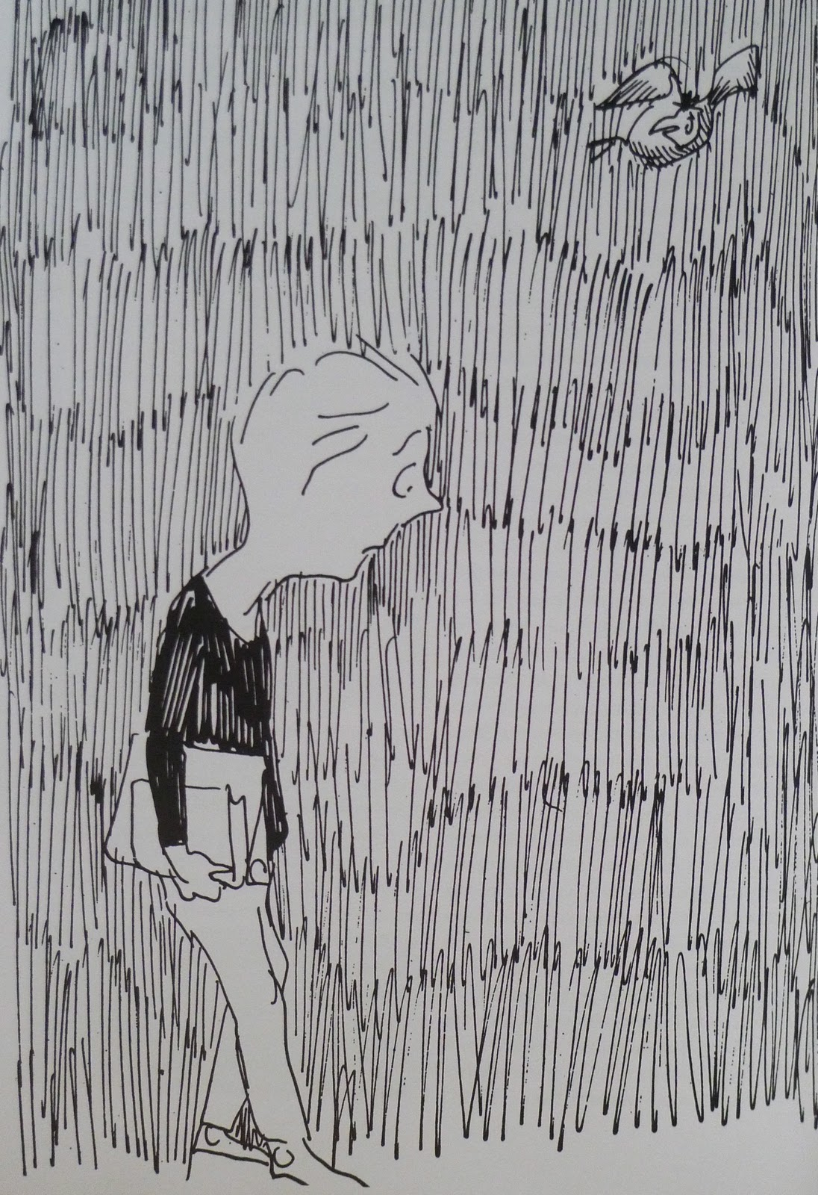
Character Traits: Milo
Place met:
Lesson learned:
Traits:

Slide 48
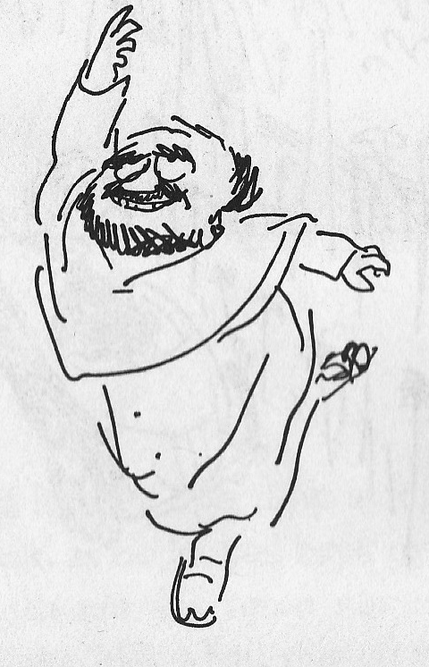
Character Traits: Whether Man
Place met:
Lesson learned:
Traits:

Slide 49
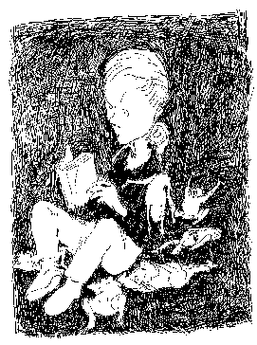
Character Traits: Lethargarians
Place met:
Lesson learned:
Traits:

Slide 50
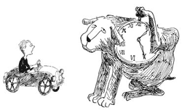
Character Traits: Tock
Place met:
Lesson learned:
Traits:

Slide 51
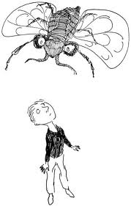
Character Traits: Spelling Bee
Place met:
Lesson learned:
Traits:

Slide 52
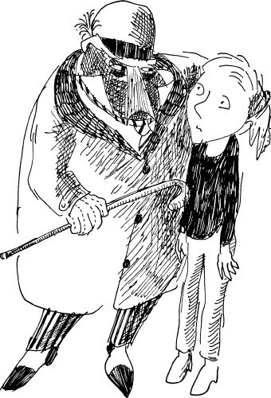
Character Traits: Humbug
Place met:
Lesson learned:
Traits:

Slide 53
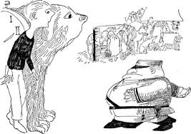
Character Traits: Short Shrift
Place met:
Lesson learned:
Traits:

Slide 54
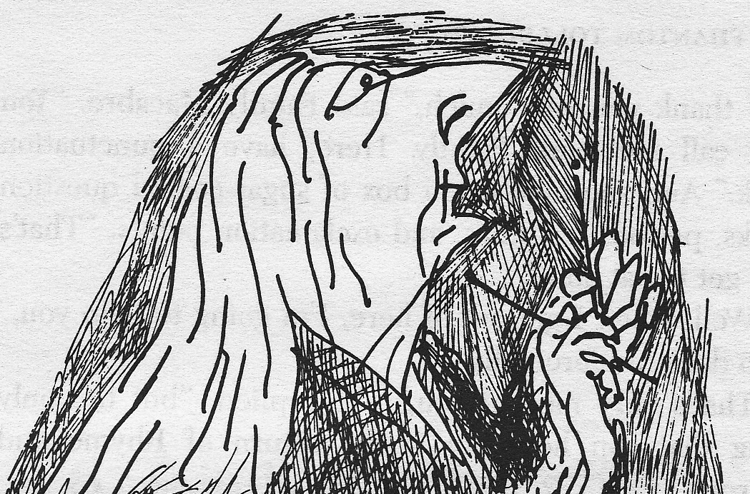
Character Traits: Faintly Macabre
Place met:
Lesson learned:
Traits:

Slide 55
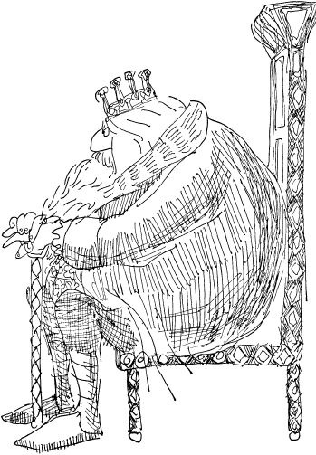
Character Traits: King Azaz
Place met:
Lesson learned:
Traits:

Slide 56
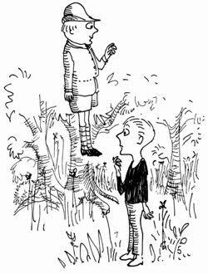
Character Traits: Alec Bings
Place met:
Lesson learned:
Traits:

Slide 57
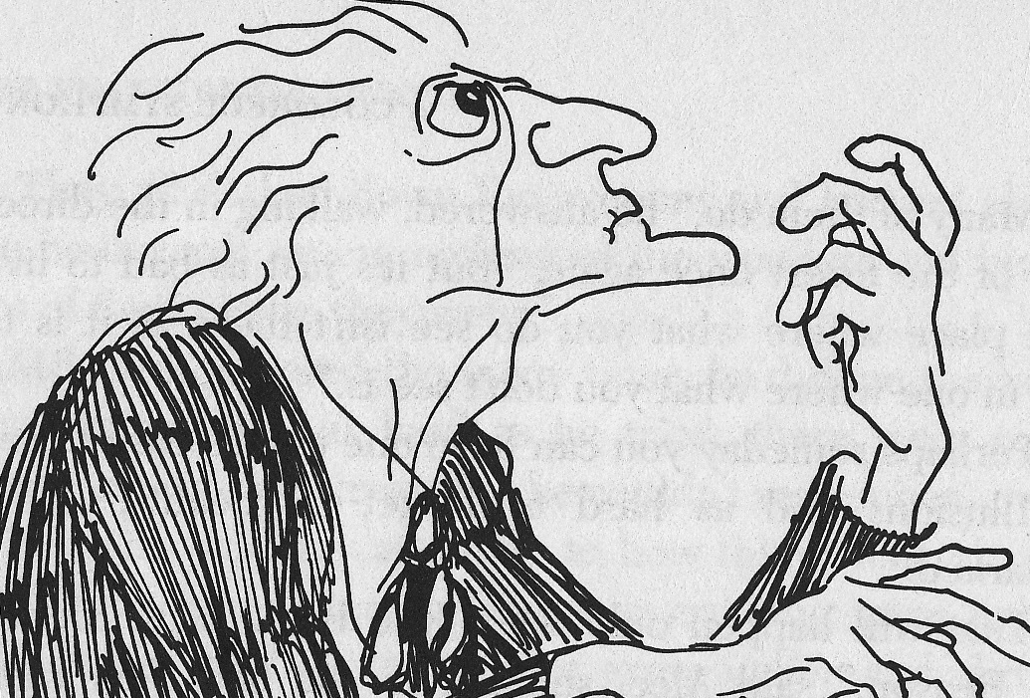
Character Traits: Chroma
Place met:
Lesson learned:
Traits:

Slide 58
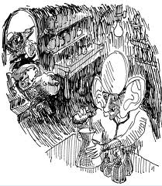
Character Traits: Dr. Dischord
Place met:
Lesson learned:
Traits:

Slide 59
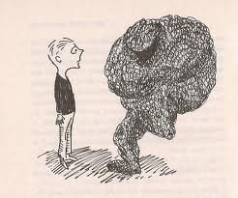
Character Traits: Dynne
Place met:
Lesson learned:
Traits:

Slide 60
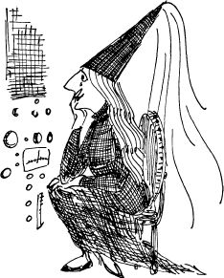
Character Traits: Soundkeeper
Place met:
Lesson learned:
Traits:

Slide 61
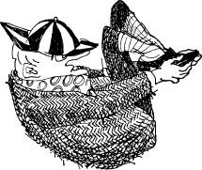
Character Traits: Canby
Place met:
Lesson learned:
Traits:

Slide 62
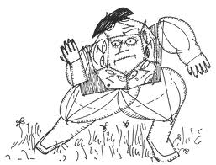
Character Traits: Dodecahedron
Place met:
Lesson learned:
Traits:

Slide 63
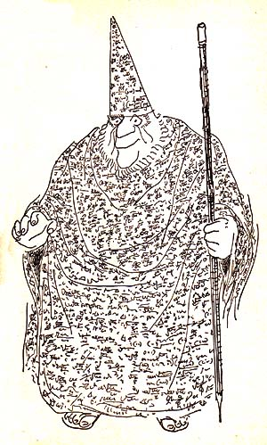
Character Traits: Mathemagician
Place met:
Lesson learned:
Traits:

Slide 64
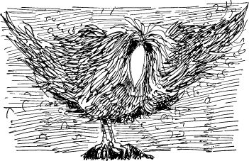
Character Traits: Very Dirty Bird
Place met:
Lesson learned:
Traits:

Slide 65
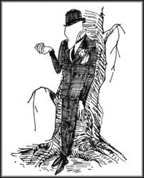
Character Traits: Terrible Trivium
Place met:
Lesson learned:
Traits:

Slide 66
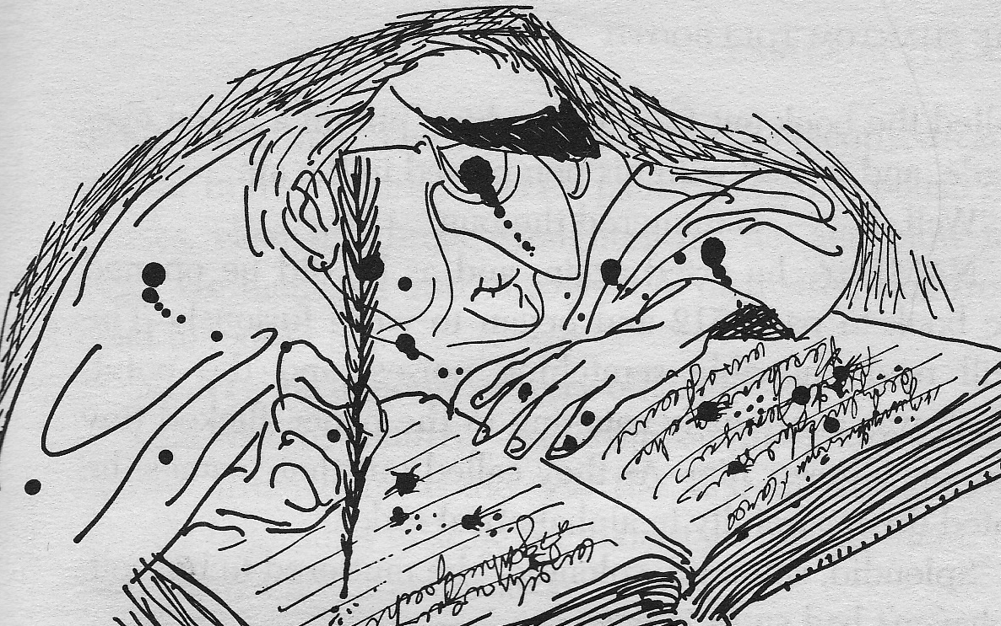
Character Traits: Senses Taker
Place met:
Lesson learned:
Traits:

Slide 67
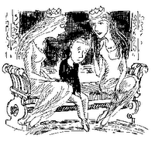
Character Traits: Rhyme & Reason
Place met:
Lesson learned:
Traits:

Slide 68
Alliteration
Page | Example

Slide 69
Homographs, Homonyms, Homophones
Page | Word 1 & Meaning | Word 2 & Meaning | Term

Slide 70
Hyperbole
Page | Example

Slide 71
Idiom
Page | Literal Meaning | Figurative Meaning

Slide 72
Irony
Page | Example | Meaning

Slide 73
Metaphor
Page | Example

Slide 74
Onomatopoeia
Page | Example

Slide 75
Personification
Page | Example

Slide 76
Pun
Page | Example | Meaning

Slide 77
Simile
Page | Example

