Slide 1
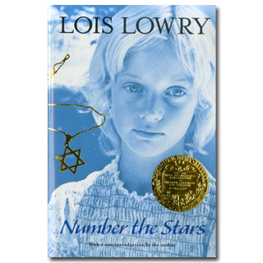
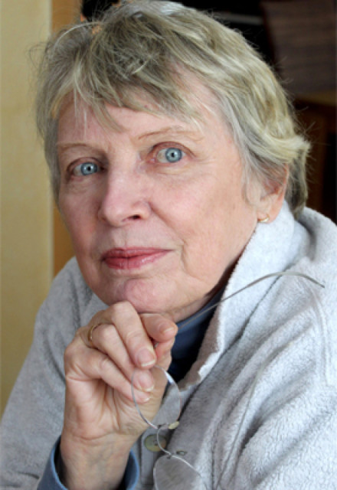
Number the Stars
Lois Lowry

Slide 2
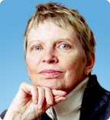
Lois Lowry
Biography

Slide 3
1. Why Are You Running? pp1-10
Vocabulary
civilized
contempt
resistance
impassive
Plotting Events
In our culture, we are taught to be unique and to stand out. In the Danish culture during World War II, it was better to be one of the crowd, to be one of many. Why?
How would you feel if a soldier stopped you to question you?

Slide 4
2. Who Is the Man Who Rides Past? pp11-17
Vocabulary
trousseau
Plotting Events
Allusion: Hans Christian Andersen, The Little Mermaid
Research: King Christian X of Denmark, Amamlienborg Palace at Copenhagen
The author, Lois Lowry, choose to use a fairy tale to contrast life during World War II. What was Annemarie’s life like before the Germans invaded Denmark three years ago?

Slide 5
3. Where Is Mrs. Hirsch? pp18-26
Vocabulary
haughtily
swastika
tormenting
Plotting Events
Would you die to protect your best friend?
Are ordinary people called upon to be courageous? Make a connection by finding an example.

Slide 6
4. It Will Be a Long Night pp27-38
Vocabulary
glowering
exasperated
disdainfully
belligerently
relocation
dubiously
Plotting Events
Allusion: Gone with the Wind
Research: Tivoli Gardens, Copenhagen
Why is it going to be a long night?
How would you feel if you were Ellen and your parents had left you and you had no idea where they were?

Slide 7
5. Who Is the Dark-Haired One? pp39-49
Vocabulary
imperious
intoned
contentedly
Plotting Events
What will the Johansens do now that the soldiers have come once and are suspicious that ‘Lise’ (Ellen) is not their daughter? What would you do in their situation?

Slide 8
6. Is the Weather Good for Fishing? pp50-59
Vocabulary
tentatively
Plotting Events
In each chapter, Kirsti always seems just about to get the family into trouble. Does she mean to do this? Will she eventually make a mistake that could cost Ellen her life?

Slide 9
7. The House by the Sea pp60-66
Vocabulary
Plotting Events
Research: Sweden
Map Skills: Denmark and Sweden

Slide 10
8. There Has Been a Death pp67-73
Vocabulary
ruefully
Plotting Events
Allusion: Thor
Annemarie doesn’t recall a relative named Birte. Do you think there really has been a death? What else could it be?

Slide 11
9. Why Are You Lying? pp74-81
Vocabulary
deftly
wryly
Plotting Events
What does bravery mean to you?
Is lying ever justified?
How do you think Ellen is feeling now that she had been reunited with her parents?

Slide 12
10. Let Us Open the Casket pp82-87
Vocabulary
condescending
Plotting Events
Who are what do you think is in the casket?

Slide 13
11. Will We See You Again Soon, Peter? pp 88-94
Vocabulary
protruding
Plotting Events
What do you think the packet contains?
Where does pride come from? What are you proud of in your life?

Slide 14
12. Where Was Mama? pp95-100
Vocabulary
Plotting Events
Do you agree with Annemarie’s statement that it is harder for the ones waiting? Explain.
What do you think happened to Annemarie’s mom?

Slide 15
13. Run! As Fast As You Can! pp101-105
Vocabulary
Plotting Events
Would you be brave enough to deliver the packet alone knowing there are soldiers out?
Have you ever done anything brave?

Slide 16
14. On the Dark Path pp106-112
Vocabulary
vivid
brusque
tantalize
Plotting Events
Allusion: Little Red Riding Hood
What do you think will happen to Annemarie? Will she deliver the package on time?

Slide 17
15. My Dog Smells Meat! pp113-119
Vocabulary
consumed
insolently
implored
caustic
quavering
Plotting Events
Why do you think the white handkerchief is so important? What could it be for?

Slide 18
16. I Will Tell You Just a Little pp120-127
Vocabulary
concealed
Plotting Events
Research: Why did the Nazis want Sweden to remain free?

Slide 19
17. Al This Long Time pp128-132
Vocabulary
Plotting Events
Do you think the Rosens are still alive? Will they return to Copenhagen? Explain.

Slide 20
Afterword pp133-137
Vocabulary
deprivation
permeated
decency
Final thoughts?

Slide 21
Novel Projects
Response to Literature: Write a response to literature explaining your views on the theme of the story.
Write a narrative about one of the following options:
The Rosens escape to Sweden
The return of the Rosens to Copenhagen
One of Peter Neilsen’s Resistance missions

