Slide 1
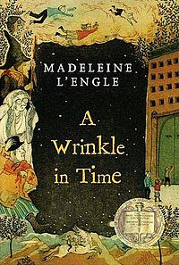
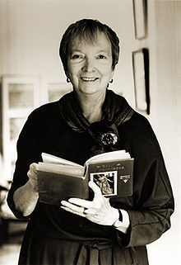
A Wrinkle in Time
Madeleine L’Engle

Slide 2
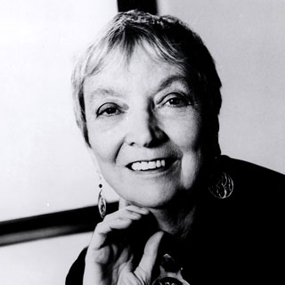
Madeleine L’Engle
Biography

Slide 3
1. Mrs Whatsit pp7-27
Vocabulary
wraith
crossly
scornfully
delinquent
smugly
serenity
savagely
constable
subsided
vulnerable
exclusive
prodigious
sullen
cunning
supine
agility
frivoling
tesseract
Character Development: Meg, Charles Wallace, Mrs. Murray
Figuratively Language
What does the phrase ‘It was a dark and stormy night,’ evoke?
Draw a picture of Mrs Whatsit. Describe what kind of a person she is.
Where do you think Meg’s father is?
Notes:
Idiom: a happy medium

Slide 4
2. Mrs Who pp28-44
Vocabulary
piteous
avid
bellowing
antagonistic
tractable
confidingly
snide
sagely
inadvertently
indignation
placidly
dilapidated
sinister
raucous
peremptory
assimilate
Character Development
Figurative Language
What special powers does Charles Wallace seem to have? Use evidence to support your thinking.
Why does Calvin feel as though he is going home when he has never even been to the Meg’s house before?
What do you make of Mrs Who?

Slide 5
3. Mrs Which pp45-63
Vocabulary
gamboled
somber
judiciously
essence
genesis
morass
tangible
paltry
materialize
Character Development: How is Meg changing?
Figurative Language
Allusion: Genesis
Who or what are Mrs Whatsit, Mrs Who, and Mrs Which?
Where are Charles Wallace, Meg, and Calvin going?
Notes:
Idiom: red herring

Slide 6
4. The Black Thing pp64-83
Vocabulary
corporeal
inexorable
gales
ephemeral
exaltation
metamorphose
Character Development
Figurative Language
Draw an illustration of the creature Mrs Whatsit.
Draw an illustration of Uriel.
Explain how the kids traveled to Uriel.
Do you believe in time and space travel? Explain why or why not.

Slide 7
5. The Tesseract pp84-101
Vocabulary
perturbed
dissolution
protoplasm
nondescript
raptly
sonorous
reverberated
Character Development
Figurative Language
Astronomy Connection: Orion’s Belt
Comment on the statement: We can’t take credit for our talents; it’s how we use them that counts.
The kids are beginning to understand the magnitude of the situation. How will three kids be able to rescue Mr. Murry and save universes from Evil, the Powers of Darkness?
Notes:
Astronomy connection: Orion’s Belt

Slide 8
6. The Happy Medium pp102-126
Vocabulary
anticlimax
chiding
myopic
malignant
precipitously
propitious
talisman
resilience
furtive
aberration
arrested
Character Development
Figurative Language
Allusion: Shakespeare’s The Tempest
What gifts do Mrs Whatsit, Mrs Who, and Mrs Which give to the children? Make a chart.
How will these gifts help the kids?
Why is everything so routine on Camazotz?
Do you think the children should go to CENTRAL Central Intelligence? Explain why or why not.

Slide 9
7. The Man with Red Eyes pp127-146
Vocabulary
bilious
warily
bravado
requisition
obliquely
chortling
gallivanting
menace
diverting
tenacity
Character Development
Figurative Language
Why did Charles Wallace concede to the man with the red eyes? Do you think it was wise of him?
What will happen now? Will Meg and Calvin be able to protect Charles Wallace?
Who or what is the man with the red eyes?
Notes:
Symbolism of crossing the threshold

Slide 10
8. The Transparent Column pp147-158
Vocabulary
spindly
pinioned
connotations
pedantic
annihilate
ominous
sadist
emanate
Character Development
Figurative Language
Do you believe differences are what create problems? Would everyone be happy if we were all alike, if we were all the same like on Camazotz?
What are the pros and cons of a society like the one on Camazotz?

Slide 11
9. IT pp159-179
Vocabulary
dais
omnipotent
systole
diastole
miasma
ruthlessly
cerebrum
cerebellum
Character Development
Figurative Language
If Mr. Murry tessered with Meg, when and where did they go? Did they leave behind Charles Wallace and Calvin? On what do you base your answer?

Slide 12
10. Absolute Zero pp180-193
Vocabulary
atrophied
frigid
inverted
fallible
assuaged
Character Development
Figurative Language
Should Mr. Murry have tessered with Charles Wallace or not? Explain.
Who or what could the Things be? Where are they taking Meg? Do you think the Thing will help or harm Meg? Explain.

Slide 13
11. Aunt Beast pp194-211
Vocabulary
trepidation
frank
acute
pungent
exert
perplexity
temporal
despondency
Character Development
Figurative Language
Do you think us humans are limited in communication? How important is it in our world to be able to communicate articulately?
Will they be able to save Charles Wallace with help from the beasts and from Mrs Whatsit, Mrs Who, and Mrs Which?
The concept of God is very apparent in this chapter (and throughout the book). Do you believe this relevant to Meg’s journey? What is the author’s message?

Slide 14
12. The Foolish and the Weak pp212-232
Vocabulary
appallingly
formidably
ministrations
confound
prevail
unadulterated
vestige
catapulted
Character Development
Figurative Language
What gifts does Meg receive this time?
What is Meg’s only true weapon?
Make a connection to other stories.
Describe Meg’s journey. What did she learn?
Where could the Mrs W’s possibly be going and to do what?
Do you like the ending? Explain.
Notes:
Metaphor: Sonnet for life

Slide 15
Novel Projects
Response to Literature:
Narrative

